Slide 1
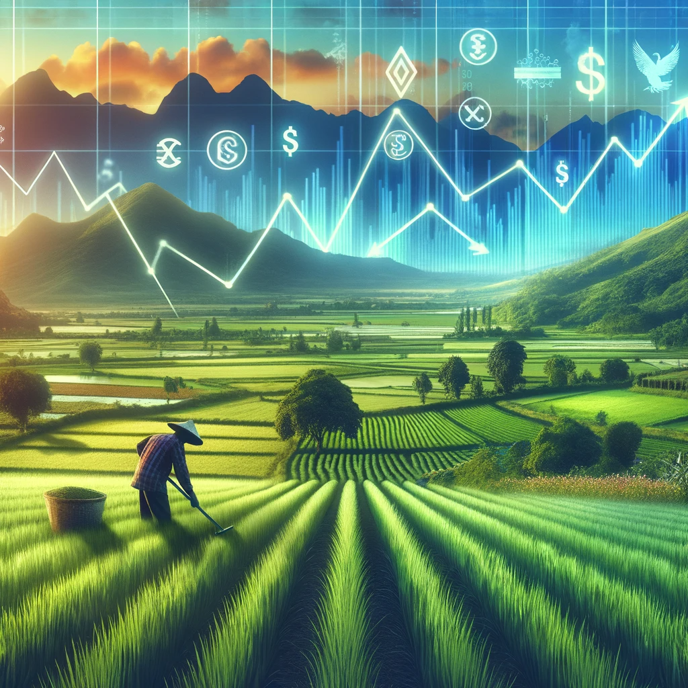
How does agricultural activity impact economic development in different countries?

Slide 2
Introduction
Agriculture is not only the backbone of many economies, especially in developing countries, but also a crucial component of the socio-economic fabric.
As the world’s population has increased, growth in productivity has produced more abundant and cheaper food.
In most developing countries, agriculture accounts for a large fraction of the economy with large majorities of the population earning their livelihoods form agriculture. And it is generally well-known economic trend that as a country gets more prosperous its economy becomes less dependent on agriculture.

Slide 3
Questions
How does agricultural activity impact economic development in different countries?
What is the relationship between agricultural productivity and GDP
What is the relationship between agricultural employment and economic growth?
What are the economic impacts of agricultural technologies?
What is the relationship between credit to agriculture and economic outcomes?

Slide 4
Finding Data
FAOSTAT - Credit to agriculture
The World Bank - GDP (current US$)
The World Bank - Agriculture, forestry, and fishing, value added (% of GDP)
Our World in Data
Cereal Yields
Fertilizer & Pesticides use
Human development index

Slide 5
Cleaning Data
Remove NaN entries
Find the intersection of countries in the three datasets with %in%
Convert text to integer or long values when relevant
Filter relevant data using tidy
Merge relevant data into one data frame
Merge datasets with the pandas merge function (in case of python files)
Remove duplicate values in data frames with pandas

Slide 6
Agricultural Productivity and GDP
GDP measures the total monetary value of all goods and services generated within the borders of a country and is also an overall measure of a country’s economic health
Cereal yield includes wheat, rice, maize, barley, oats, rye, millet, and other grains and provide more food than any other type of crop
What is the relationship between GDP and annual cereal yield?

Slide 7
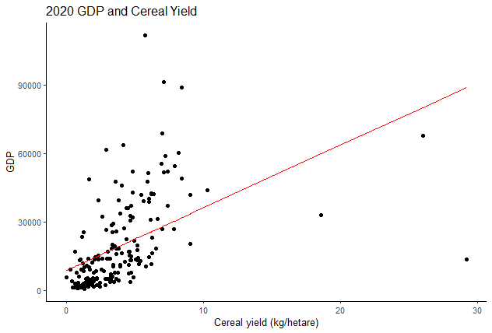
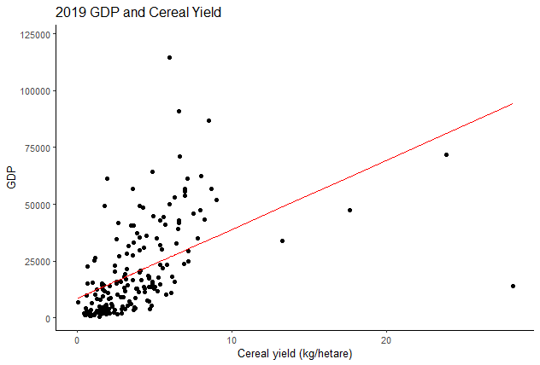
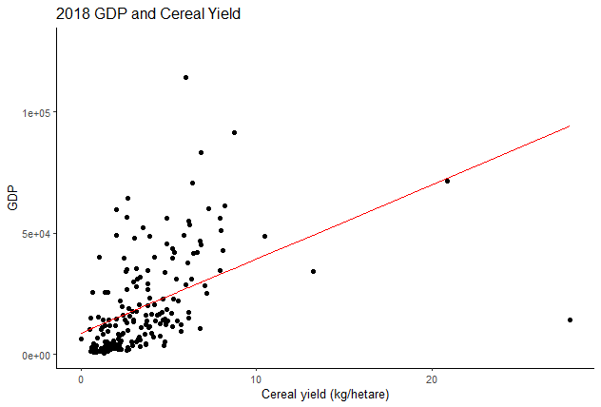
Plotting Data
Used ggplot (geom_point and geom_line) for GDP and Cereal Yield
The relationship between cereal yield and GDP for all countries with available data for 2020, 2019, and 2018. Each year shows a similar correlation.

Slide 8
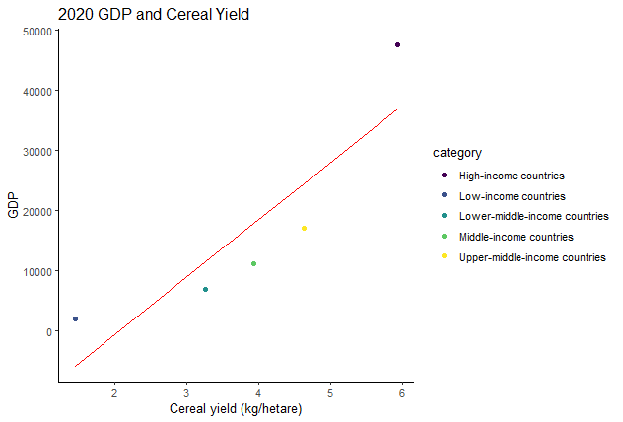


The data also provided data of countries grouped by “High-income countries", "Low-income countries", "Lower-middle-income countries", "Middle-income countries", "Upper-middle-income countries”
The relation between cereal yield and GDP for the six categories.
Each year shows a similar correlation.

Slide 9
Agriculture technology
What is the trend on the implementation of nitrogen fertilizer among the emerging and advanced economies over the past 30 years?
To what extent is the human resource in emerging economies differ from developed countries?
How does the implementation of agriculture technologies such as fertilizer and pesticide change the gap?
Portal

Slide 10
Human development index
The Human Development Index (HDI) is a composite statistical measure designed to assess and rank countries based on their overall human development. Introduced by the United Nations Development Programme (UNDP).
HDI considers three key dimensions: health (life expectancy at birth), education (mean and expected years of schooling), and standard of living (per capita income).
By combining these factors into a single index, countries with higher HDI values are generally considered to have achieved greater levels of human development.

Slide 11
Agricultural Employment and Economic Growth
Factors to look at:
GDP
GDP per capita
Annual working hours per worker
Agriculture value added per worker
Food expenditure

Slide 12
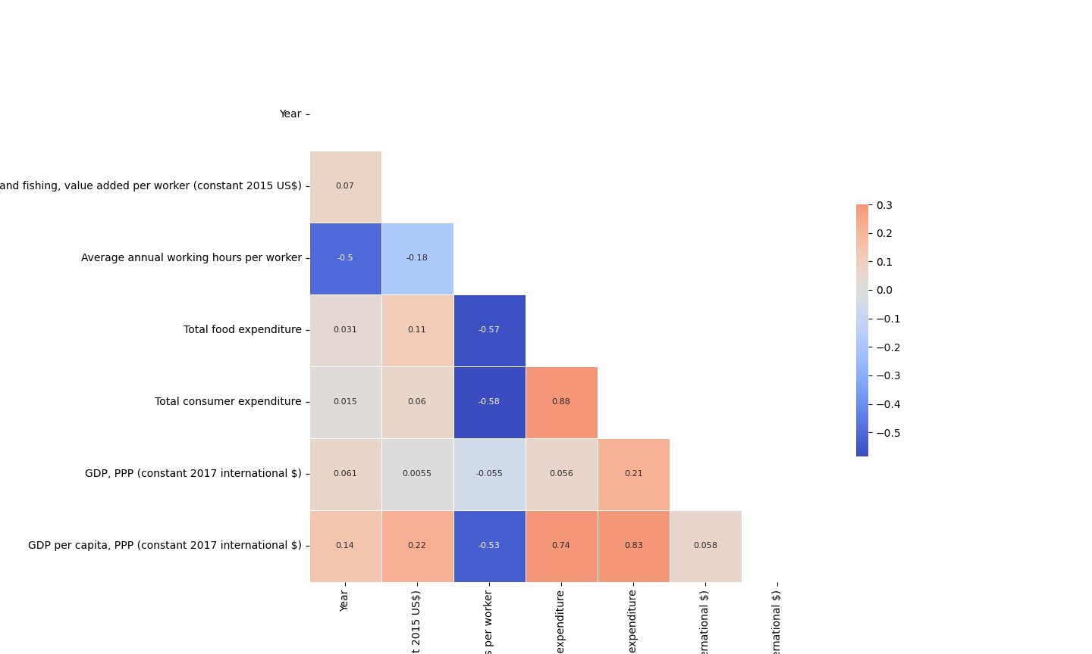
An overall look
Figure 1: A correlation Heatmap for Agricultural Value, Working Hours, Food Expenditure, GDP, GDP PPP

Slide 13
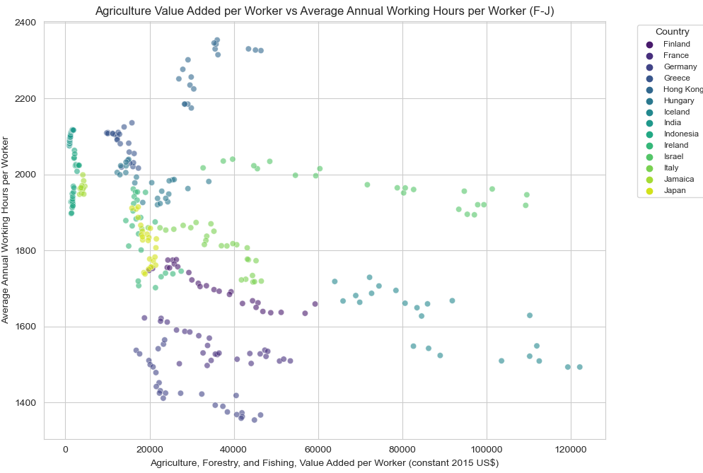
Working hours
Figure 2: Average Annual Working Hours VS Agricultural Value Added

Slide 14
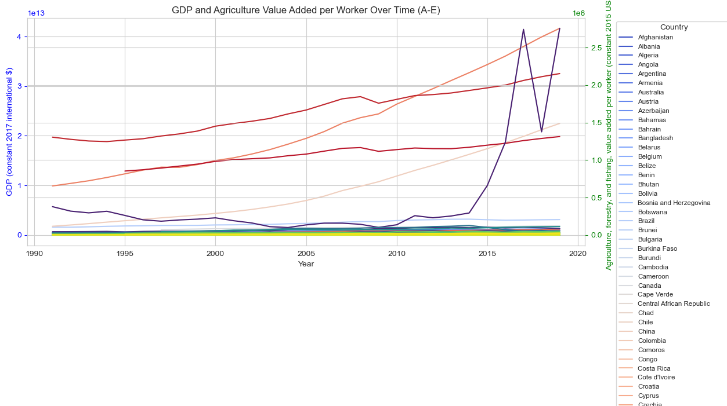
GDP Per Capita & Agricultural Value
Figure 3: Time Series with double y-axis for GDP and Agricultural Value

Slide 15
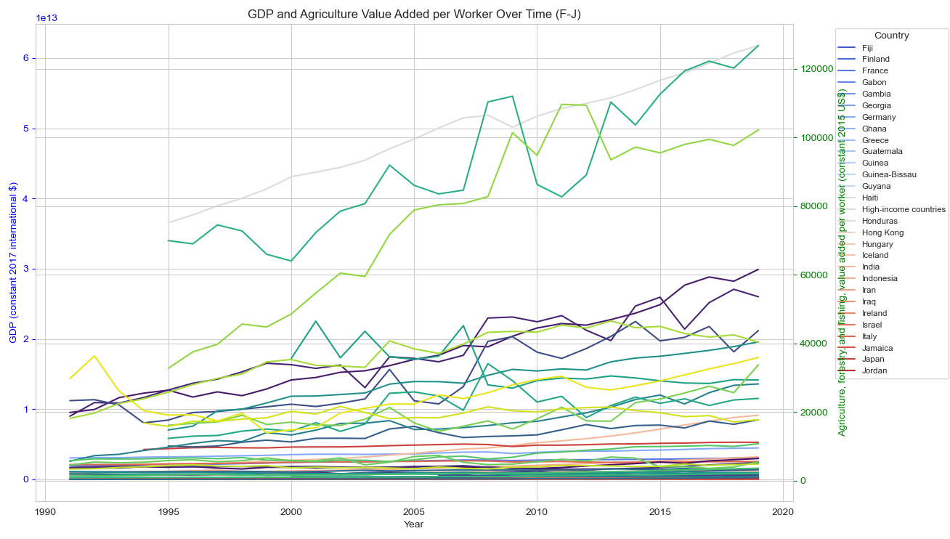
Figure 4: Time Series with double y-axis for GDP and Agricultural Value

Slide 16
Credit to Agriculture
“Credit to agriculture measures the amount of loans and advances given by the banking sector to farmers… borrowing from informal sources… may involve unduly high interest rates and unfavourable conditions, which may make many agricultural operations uneconomical.” - FAOSTAT, UN
Do poor or rich countries depend more on agriculture?
What is the relationship between a country’s dependence on agriculture and its credit to agriculture?
What is the relationship between credit to agriculture and total credit?
For agriculture in the United States, what are the trends over time?

Slide 17
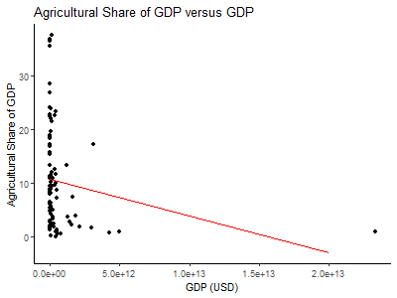
Figure 1. Agricultural Share of GDP versus GDP for 96 countries in 2021. Linear regression yields non-significant, weak, negative relationship (r² = 0.03343, p = 0.07456). GDP variables taken from World Bank.

Slide 18
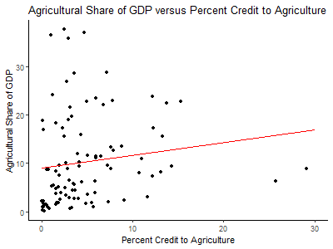
Figure 2. Agricultural Share of GDP versus Percent Credit to Agriculture for 96 countries in 2021. Linear regression yields non-significant, weak, positive relationship (r² = 0.02008, p = 0.1685). GDP data taken from World Bank. Credit data taken from FAOSTAT.

Slide 19
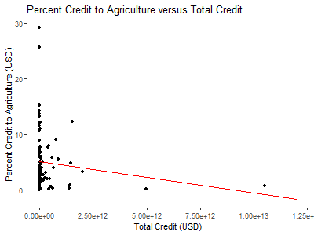
Figure 4. Percent Credit to Agriculture versus Total Credit for 96 countries in 2021. Linear regression yields non-significant, weak negative relationship (r² = 0.01882, p = 0.1826). Credit data taken from FAOSTAT.

Slide 20
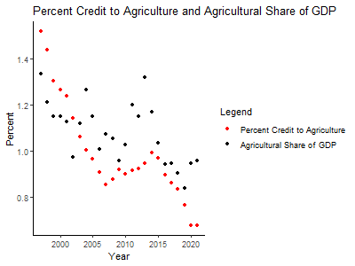
Figure 5. Percent Credit to Agriculture and Agricultural Share of GDP versus Time in the United States from 1993-2021. Linear regression (omitted) yields significant, moderate, positive relationship (r² = 0.3947, p = 0.0007713). GDP data taken from World Bank. Credit data taken from FAOSTAT.

Slide 21
Next Steps
So far, we have seen direct comparison between the growth of agriculture against economical and societal development. Further investigations on this topics could look at,
Is there any difference between merging and developed economic in terms of their response time to economic growth promoted by advancement in agricultural technology?
The relationship between agricultural stats and cost of living
Variation of the median income spent on cultivated products against GDP per capita, etc.

Slide 22
References
FAO: https://www.fao.org/food-agriculture-statistics/data-release/en/
World Bank: https://databank.worldbank.org/
OECD: https://data.oecd.org/
Our World in Data: https://ourworldindata.org/
Code: https://github.com/AlessaC14/Agriculture_Economics

